Slide 1
Purchase Pattern Analysis
Client Project Report
Project ID: CDACL005
Team Code: PTID – CDA – SEP - 25 -741
Batch: 12 – MAY – CDA – BUN – 040 – WDM1130 – BAN
Prepared By: Pruthiraj Samal (pruthirajsamal8802@gmail.com)

Slide 2
Objectives
Week – 4:
Summarize the key findings from market basket analysis
Formulate actionable business insights & recommendations
Present results to stakeholders
Document the complete analysis process

Slide 3
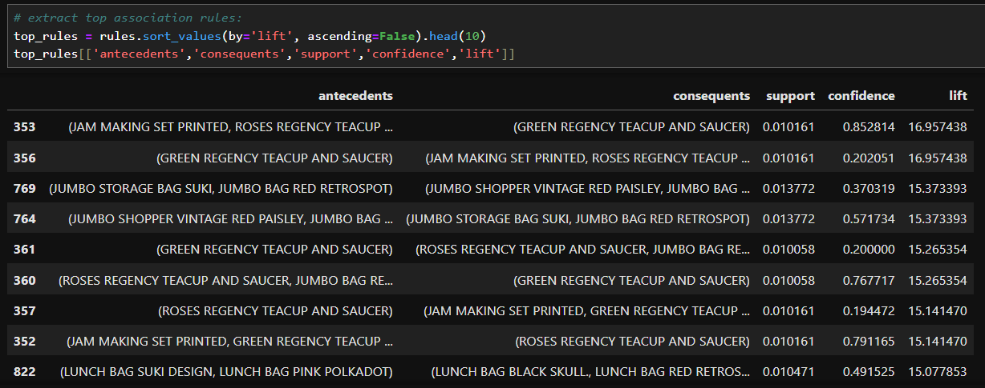
Key Findings
Top association rules (show top 5–10 rules in a table or bullets)
  Example: Milk → Bread (Support: 0.08, Confidence: 0.75, Lift: 1.8)
Frequent itemsets
High-lift product pairs indicate strong associations

Slide 4
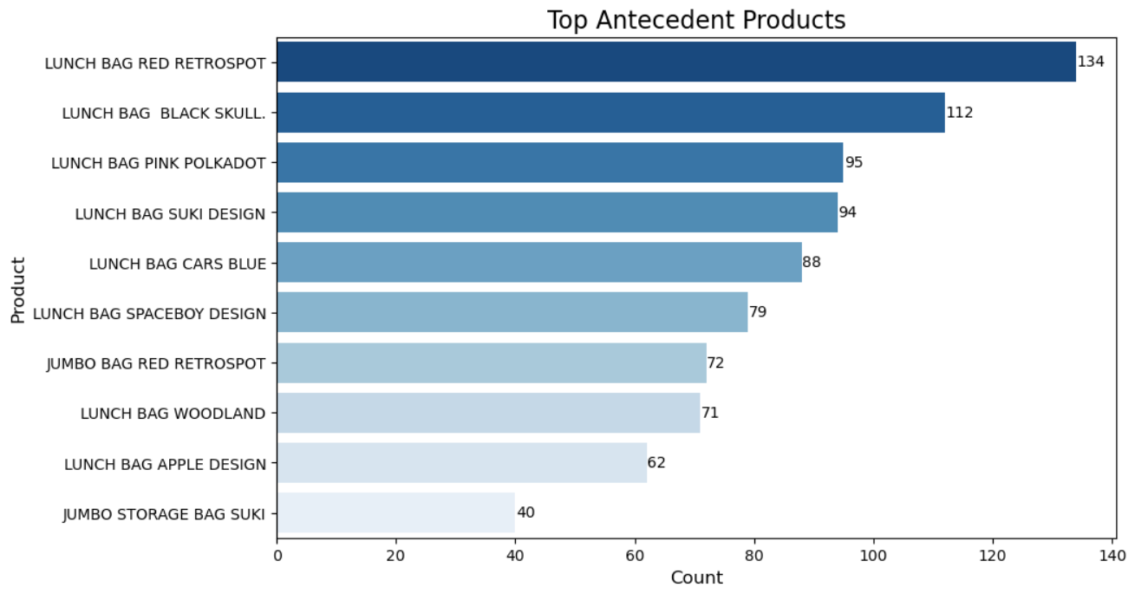
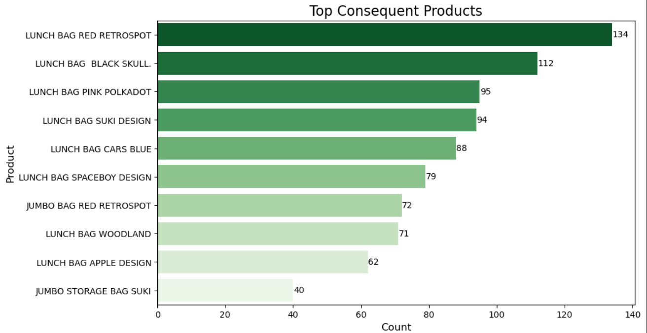
Visual Insights
Bar charts of top antecedents and consequents

Slide 5
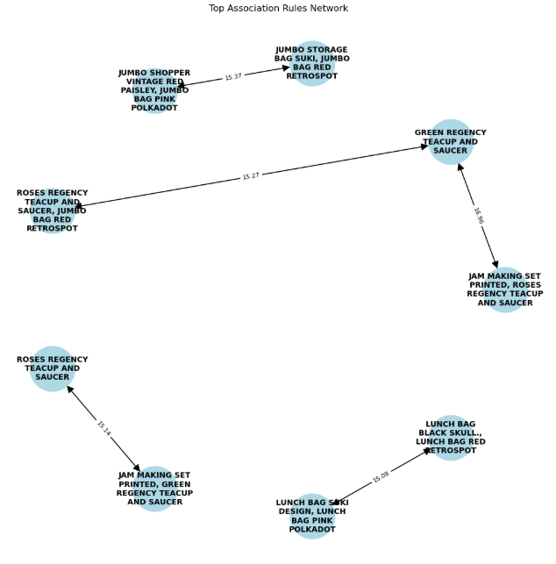
Network graph of top association rules

Slide 6
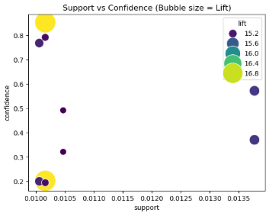
Support vs Confidence scatter plot

Slide 7
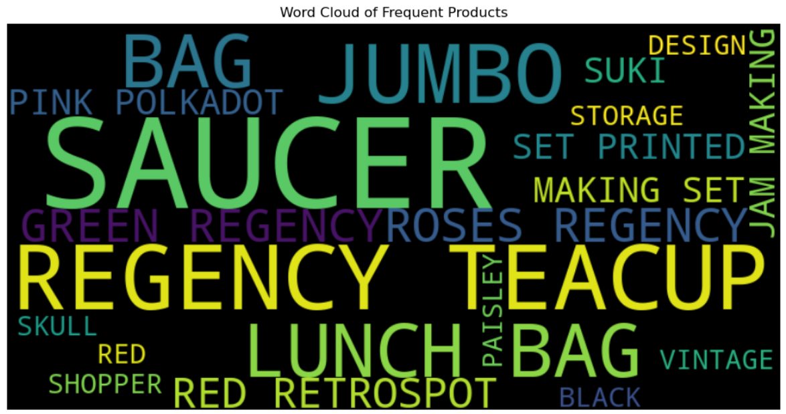
Word Cloud of Frequent Product

Slide 8
Insights & Recommendations
Cross-sell opportunities for frequently purchased items
Optimize inventory for high-demand products
Bundle high-lift product combinations
Targeted marketing strategies based on purchase patterns

Slide 9
THANK YOU

